Slide 1

Depreciation

Slide 2
Learning Outcomes
Appraise the treatment of depreciation to be charged on the useful life of PPE.

Slide 3
Meaning of Depreciation
The monetary value of an asset decreases over time due to use, wear and tear or obsolescence.
This decrease is measured as depreciation.

Slide 4
A.) Charging Depreciation on PPE
Each part of an item of property, plant and equipment with a cost should be depreciated separately.
The depreciation expense for each period should be recognised in the statement of profit and loss.
The depreciable amount of an asset should be allocated on a systematic basis over its useful life.

Slide 6
Problem Solving – I
A company buys a new computer at the cost of $5000. It will have a salvage value of $200 at the end of useful life.
The useful life of computer is 3 years.
Calculate the amount of depreciation on the basis of straight line method.

Slide 7
Solution
Step I: $5,000 purchase price - $200 salvage value = $4,800
Step 2: $4,800 ÷ 3 years estimated useful life = $1,600
$1,600 annual straight line depreciation expense.

Slide 8
Poll – I
A theme park purchased a new, exciting ride and financed it through the manufacturer. The following facts pertain to purchase of ride:
Purchase Price = $50,000
Delivery cost = $10,000
Installation cost = $5000
The straight-line method is to be used. The depreciation on the equipment for the first year assuming an estimated service life of 5 years.
$10,000
$12,000
$13,000
$15,000

Slide 9
Problem Solving – II
A Company has purchased a plant and machinery in the month of April 2009 and it was depreciating the said machinery by applying WDV method @ 13.91% p.a.
Calculate the amount of depreciation on the basis of WDV method.

Slide 10
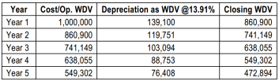
Solution

Slide 11
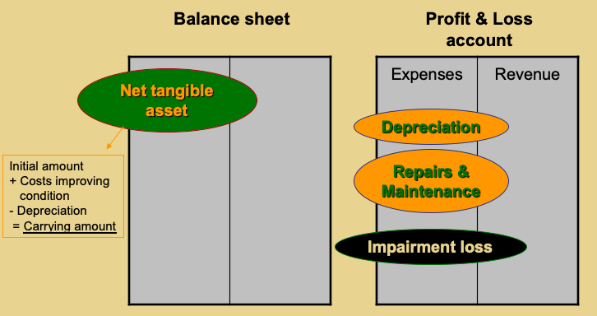
Measurement Summary

Slide 12
B.) Disclosure under IND AS – 16
The financial statements should disclose, for each class of property, plant and equipment:
the measurement base used for determining the gross carrying amount of asset
Depreciation methods used;
Carrying amount of each asset
Additions made in the asset
Impairment losses on asset

Slide 13
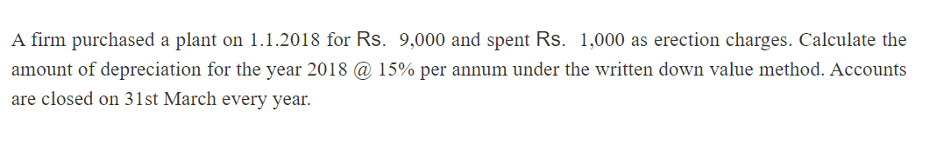
Practical Questions

Slide 14
Ans
Original cost = 9,000 + 1,000 = 10,000
Rate of depreciation = 15%
Date of purchase = 1.1.2018
Number of months used = 1.1.2018 to 31.03.2018 = 3 months
Amount of depreciation = 15% on 10,000 for 3 months
= 10,000 ×15% × 3/12 = Rs. 375

Slide 15

CONFUSED!
ANY QUESTIONS?

